Slide 1





PROJECT-P775
INSURANCE ANALYTICS
03.03.25

Slide 2
PROJECT TEAM & MENTORS
Mentors
Members
Sharat Hiremath
Nandhana R
Swajal Sandeep Aparadh
Amrit Pritam
Rohan Pankaj Pardamwar
Tirumandyam Soma Sekhar Reddy
V.Saketh Reddy

Slide 3
OVERVIEW
Goal: Create an Interactive Dashboard
Tools used: MS Excel, Power BI, Tableau Public, MySQL
Current Status: Dashboard Completed

Slide 4
DATASETS DESC.
Summary: 6 datasets - Account Executives performance (Budget, Policy, Transactions)
Individual Budgets | Budget allocations for branches/employees (New roles, Cross-sell, Renewals)
Brokerage | Clients’ policy info (Policy details, Income, Renewal status)
Invoice | Invoice data (Transaction details, Associated clients)
Fees | Client-related income transactions (Revenue, Transaction types)
Meetings | Meetings by Account Execs (Branch associations, Attendee details)
Opportunities | Opportunities by Account Execs (Revenue, Stages, Risk info)
Note: Some datasets have NULL Account Exec IDs and inconsistent names.

Slide 5
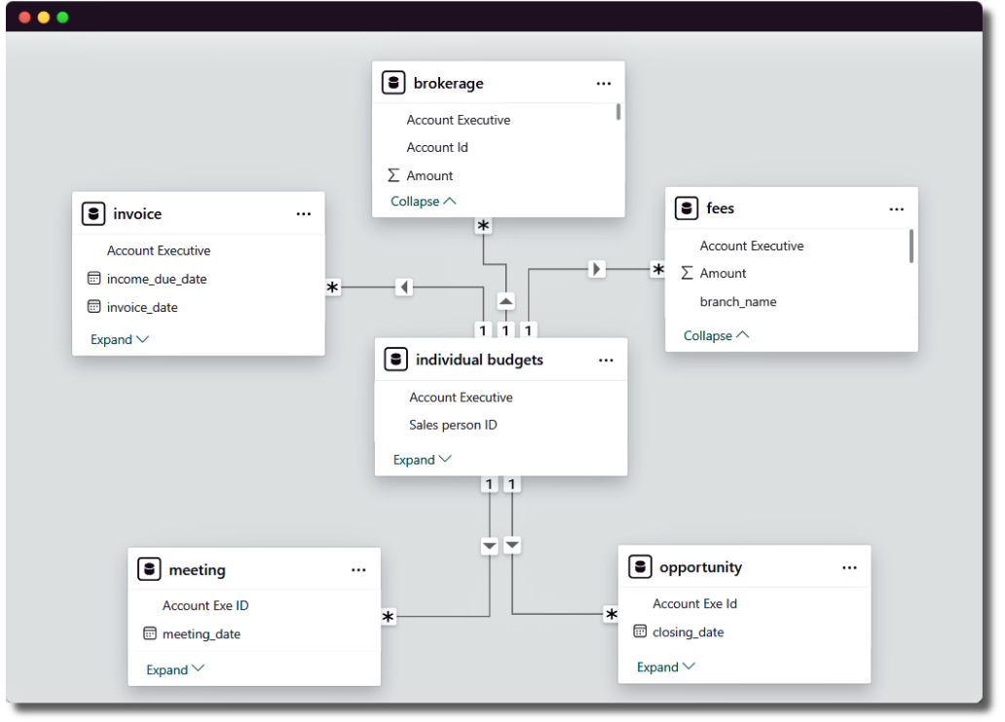
DATA SCHEMA

Slide 6
KPIS
No. of Invoices by Account Executive
Yearly Meeting Count
Cross-Sell, New, Renewal (Target, Achieved)
Stage Funnel by Revenue
No. of Meetings by Account Executive
Top Open Opportunities

Slide 7
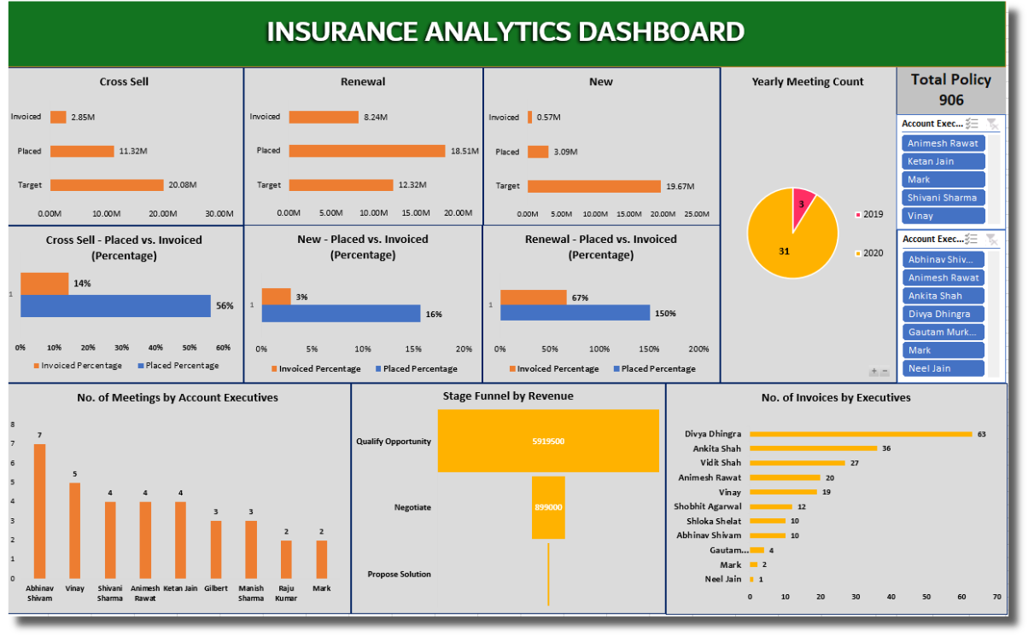
MS EXCEL DASHBOARD

Slide 8
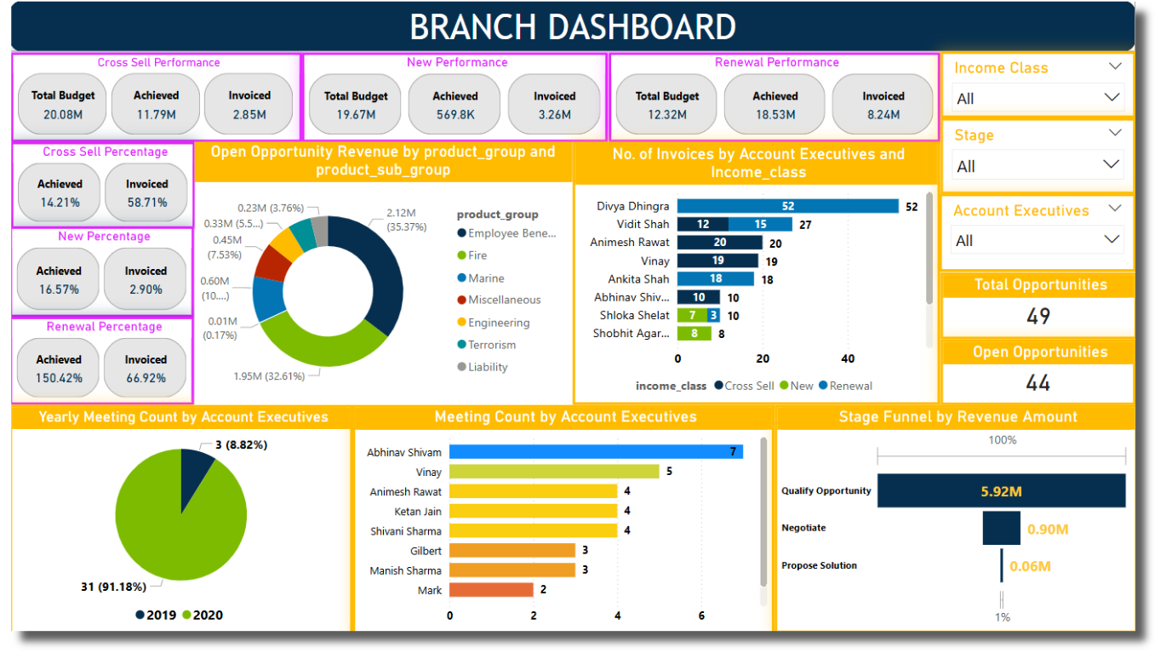
POWER BI DASHBOARD

Slide 9
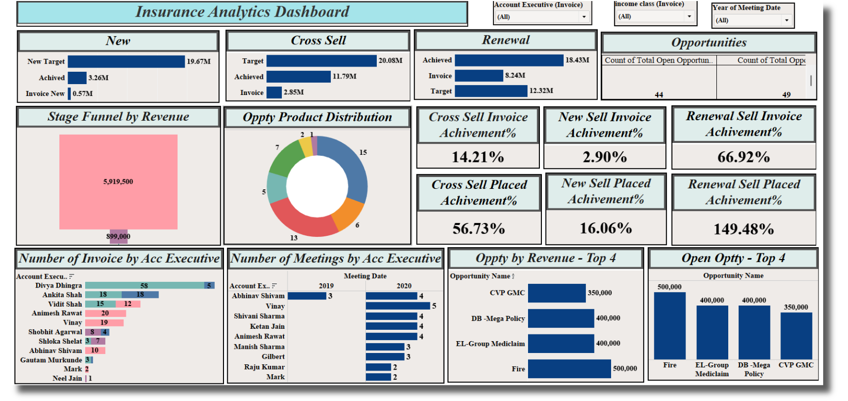
TABLEAU DASHBOARD

Slide 10
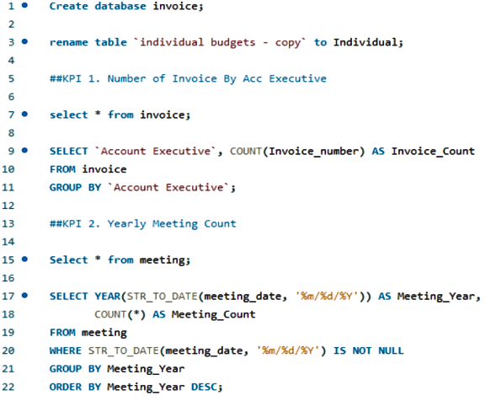
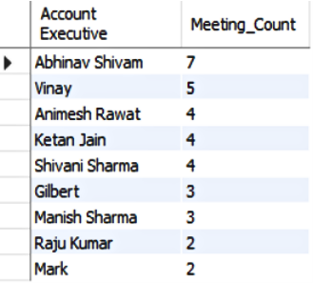
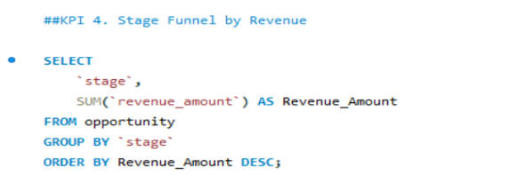
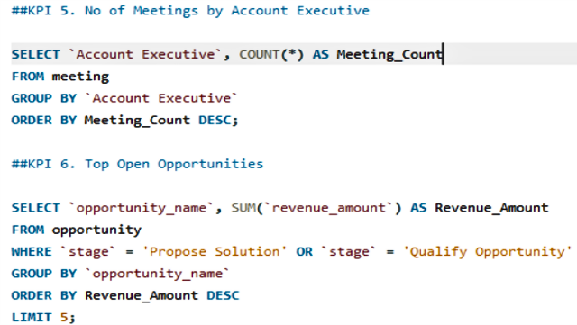
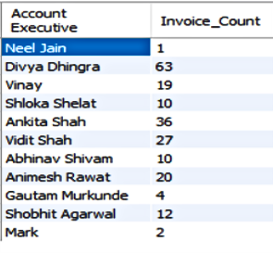
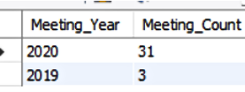
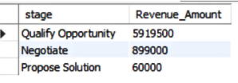
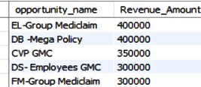
MYSQL QUERIES
2
5
1
4
5
1
6
2
4
6

Slide 11
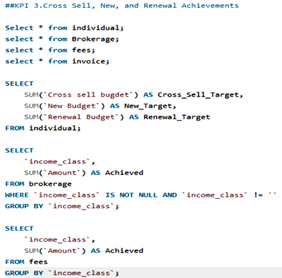
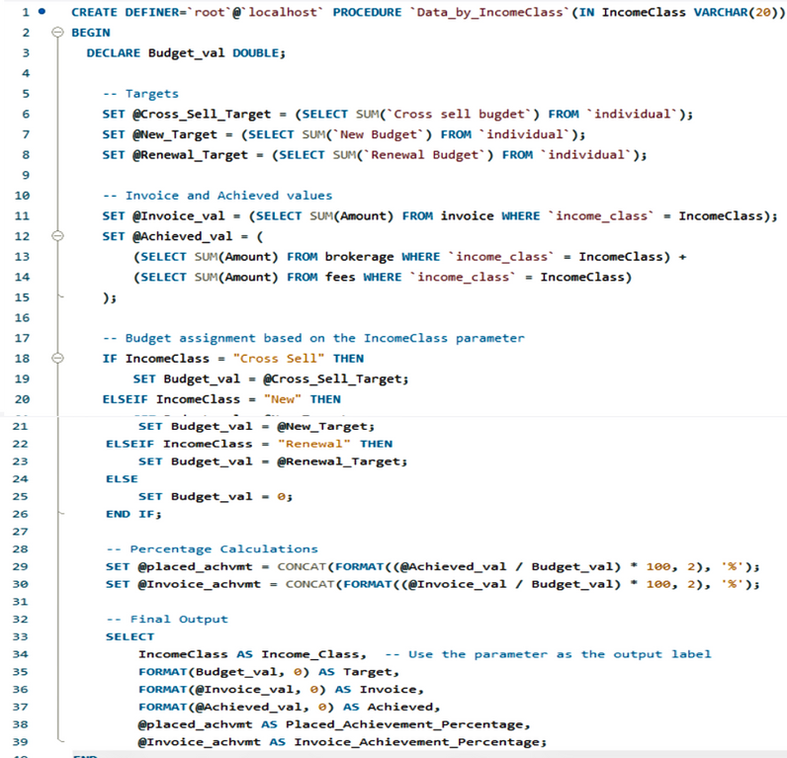



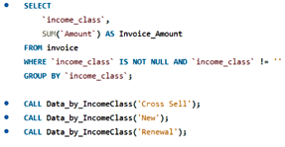

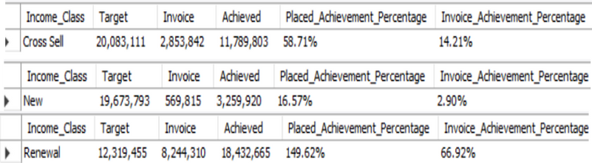
MYSQL QUERIES
KPI 3

Slide 12
CHALLENGES AND SOLUTIONS
Challenge | Impact | Solution | Status
Duplicate/ Irrelevant Values | Skewed KPI accuracy | Team cleaned datasets | Solved
Missing Account Executive IDs | Risk of misattributing performance metrics | Modified MySQL to allow NULL values | Temporary Fix
Account Executive Names mismatch across datasets | Inconsistencies in performance calculation | --------- | Not Solved

Slide 13
RECOMMENDATIONS
Standardize Account Executive IDs and Names across all 6 datasets
Improve Customer Service
Add AI chatbots for 24/7 support.
Train staff in engagement & conflict skills.
Grow Product Offerings
Offer new insurance for emerging markets.
Bundle products for customer value.
Increase Efficiency
Train staff on new tech regularly.
Encourage team collaboration.

Slide 14
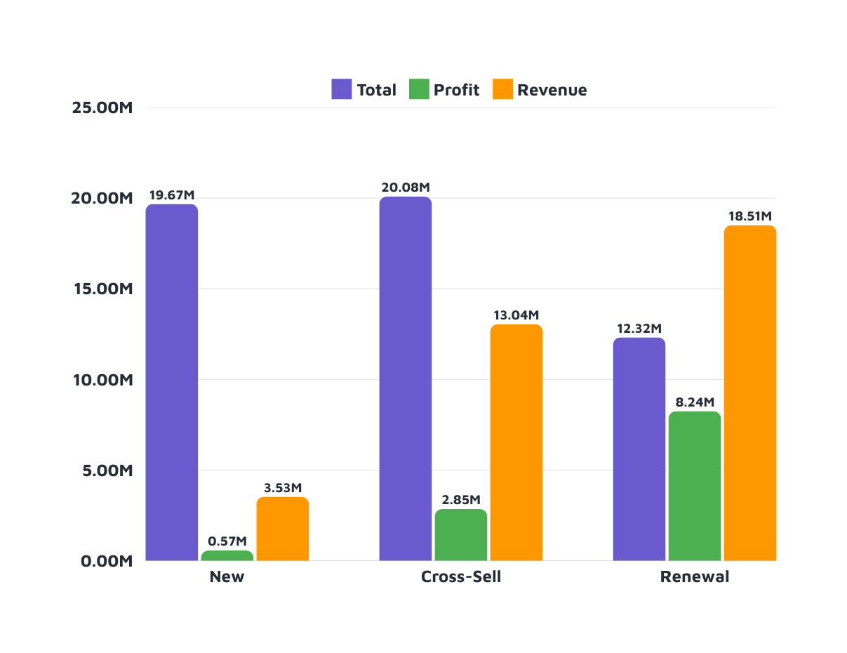

RESULT

Slide 15
CONCLUSION
New Policies
Steady growth with a decent profit margin. Need to focus on increasing the growth rate
Total: 19.674 M
Profit: 0.5698 M
Revenue: 3.5316 M
Profit Margin: 17.95%
Growth Rate: 2.90%
Cross-Sell Policies
High profitability and significant growth. Continue leveraging cross-selling opportunities
Total: 20.083 M
Profit: 2.854 M
Revenue: 13.04 M
Profit Margin: 64.94%
Growth Rate: 14.21%
Renewal Policies
Renewal Policies
Exceptional performance in renewals with very high profitability and growth. Maintain this strong focus
Total: 12.32 M
Profit: 8.244 M
Revenue: 18.507 M
Profit Margin: 150.23%
Growth Rate: 66.92%%

Slide 16
Thank You

